Slide 1
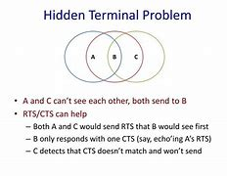
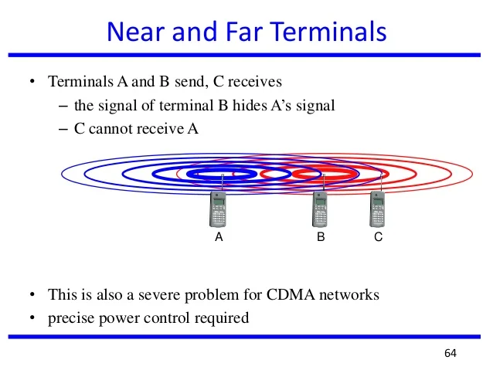
Hidden and exposed terminal Problem
Near and Fr Terminal Problem

Slide 2
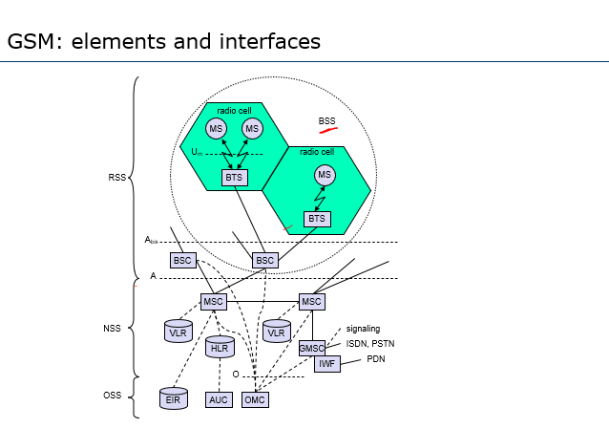
GSM

Slide 3
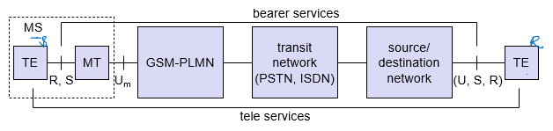
Services

Slide 4
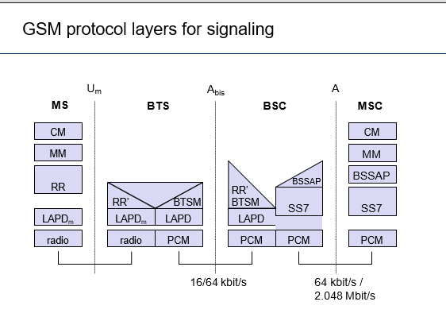

Slide 5
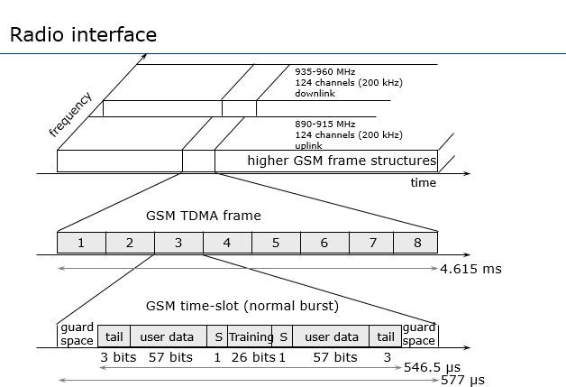

Slide 6
Mobile Originated Call (MOC) - outgoing call
1, 2: connection request
MS sends dialled number to BSS
BSS sends dialled number to MSC
3, 4: security check
MSC checks VLR if MS is allowed
the requested service. If so, MSC asks
BSS to allocate resources for call.
5-8: check resources (free circuit)
MSC routes the call to GMSC
GMSC routes the call to local exchange of called user
9-10: set up call
Answer back(ring back) tone is routed from called user to MS via GMSC,MSC,BSS
VLR
3
4
6
5
PSTN
GMSC
MSC
7
8
2
9
1
MS
BSS
10

Slide 7
Mobile Terminated Call
1: calling a GSM subscriber
2: forwarding call to GMSC
3: signal call setup to HLR
4, 5: request MSRN from VLR
6: forward responsible MSC to GMSC
7: forward call to
current MSC
8, 9: get current status of MS
10, 11: paging of MS
12, 13: MS answers
14, 15: security checks
16, 17: set up connection
4
HLR
VLR
5
8
9
3
6
14
15
calling
station
7
PSTN
GMSC
MSC
1
2
10
10
13
10
16
BSS
BSS
BSS
11
11
11
11
12
17
MS

Slide 8
MTC/MOC
MS
MTC
BTS
MS
MOC
BTS
paging request
channel request
channel request
immediate assignment
immediate assignment
paging response
service request
authentication request
authentication request
authentication response
authentication response
ciphering command
ciphering command
ciphering complete
ciphering complete
setup
setup
call confirmed
call confirmed
assignment command
assignment command
assignment complete
assignment complete
alerting
alerting
connect
connect
connect acknowledge
connect acknowledge
data/speech exchange
data/speech exchange

Slide 9
4 types of handover
1
2
3
4
MS
MS
MS
MS
BTS
BTS
BTS
BTS
BSC
BSC
BSC
MSC
MSC
Intra-cell handover (channels, time-slots within the same cell – e.g. because of narrow band interference with some frequencies)
Inter-cell, intra-BSC handover (cells within the same BSS, BSC)
Inter-BSC, intra-MSC handover (cells in different BSS but under control of same MSC)
Inter MSC handover (cells under control of different MSCs)

Slide 10
GSM - authentication
mobile network
SIM
RAND
K_{i}
RAND
RAND
K_{i}
AC
128 bit
128 bit
128 bit
128 bit
A3
A3
SIM
SRES* 32 bit
SRES 32 bit
MSC
SRES* =? SRES
SRES
32 bit
SRES
K_{i}: individual subscriber authentication key SRES: signed response

Slide 11
GSM - key generation and encryption
mobile network (BTS)
MS with SIM
RAND
K_{i}
RAND
RAND
K_{i}
AC
128 bit
128 bit
128 bit
128 bit
SIM
A8
A8
cipher
key
K_{c}
64 bit
K_{c}
64 bit
data
SRES
BSS
encrypted data
data
MS
A5
A5

Slide 12
GPRS Architecture and Interfaces
SGSN
G_{n}
MS
BSS
SGSN
GGSN
PDN
U_{m}
G_{b}
G_{n}
G_{i}
HLR/
GR
MSC
VLR
EIR

Slide 13
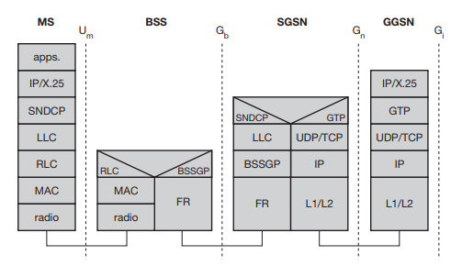
GPRS transmission plane protocol reference model

Slide 14
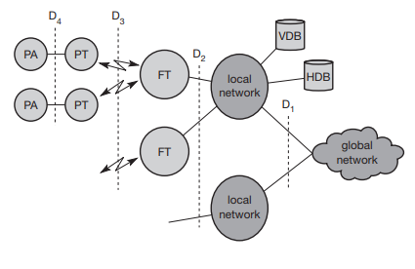
DECT system architecture reference model

Slide 15
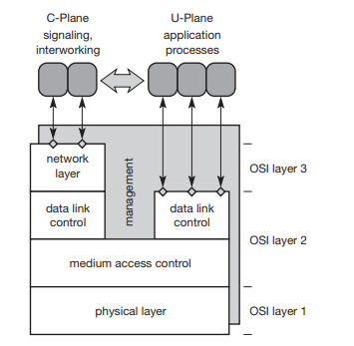
DECT protocol layers

Slide 16
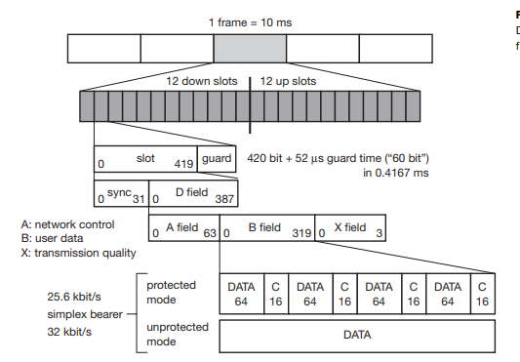
DECT multiplex and frame structure

Slide 17

UMTS

Slide 18
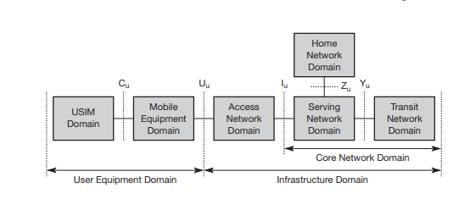
UMTS domains and interfaces

Slide 19
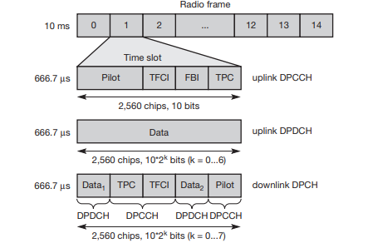
UTRA FDD

Slide 20
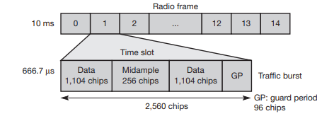
UTRA TDD

